Slide 1




AT82.02
Data Modeling and Management
Lab5: Key-Value Store [NoSQL]

Slide 2
Outline
Key-Value Store
What is Redis ?
Redis Data Structure
Common Use Cases
Notes:
https://www.sqltutorial.org/seeit/

Slide 3
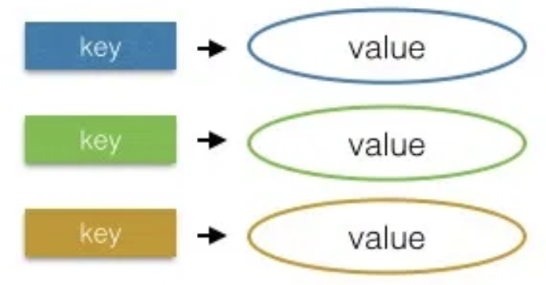
Key-Value Store
What is key-value stores ?
A key-value store is a type of nonrelational database (NoSQL).
Data is represented as a collection of key–value pairs.
Collect data as a hash table with a unique key and a pointer to a particular item of data
How do key-value stores work?
Key-value stores have no query language.
Retrieve and update data using simple get, put and delete commands
Notes:
A key-value database is a type of nonrelational database that stores data as a collection of key-value pairs in which a key serves as a unique identifier.
Data is represented as a collection of key–value pairs.
These databases store the data as a hash table with a unique key and a pointer to a particular item of data
In general, key-value stores have no query language.
They provide a way to store, retrieve and update data using simple get, put and delete commands;

Slide 4
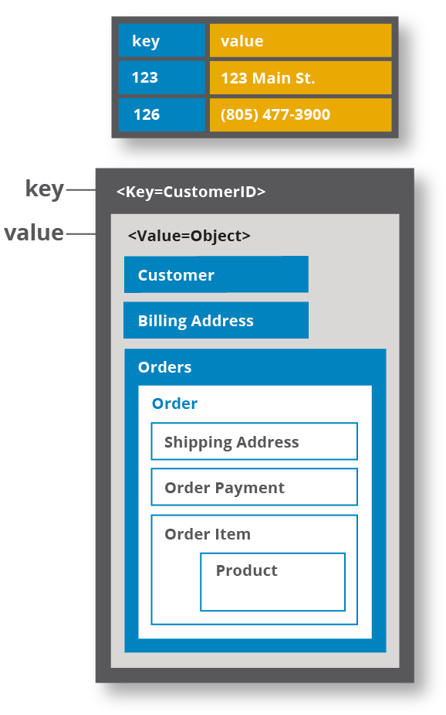
Key-Value Store
The key could be anything, but it need to be the unique identifier for an item of data
A value is either the data being identified that could be anything including a list or another key-value pair.
Key-value stores are flexible and offer very fast performance for reads and writes
Not adequate for complex applications
Notes:
The key could be anything, depending on restrictions imposed by the database software, but it needs to be unique in the database so there is no ambiguity when searching for the key and its value.
The value could be anything, including a list or another key-value pair. Some database software allows you to specify a data type for the value.
In traditional relational database design, data is stored in tables composed of rows and columns. The database developer specifies many attributes of the data to be stored in the table
Key-value stores are typically much more flexible and offer very fast performance for reads and writes, in part because the database is looking for a single key and is returning its associated value rather than performing complex aggregations.
Normally not adequate for complex applications

Slide 5



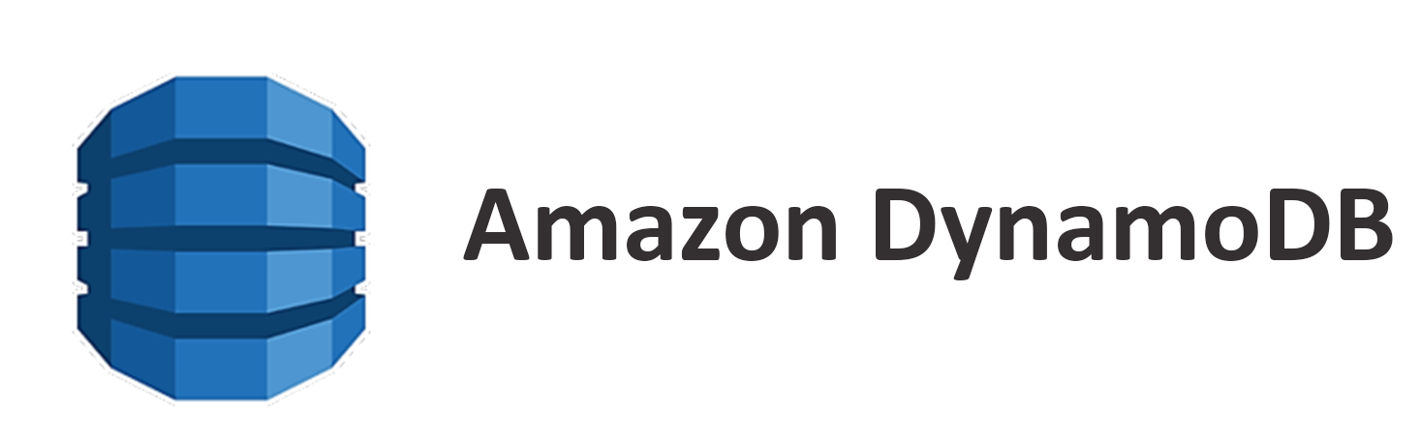

Key-Value Store
Some popular key-value stores are:

Slide 6
What is Redis?
A Key-Value Store.
Stores and manipulates all data in memory that can be used as a database, cache, and message broker.
Supports basic data structures such as strings, hashes, lists, sets, and sorted sets with range queries.
More advanced data structures like bitmaps, hyperloglogs, and geospatial indexes with radius queries are also supported.

Slide 7
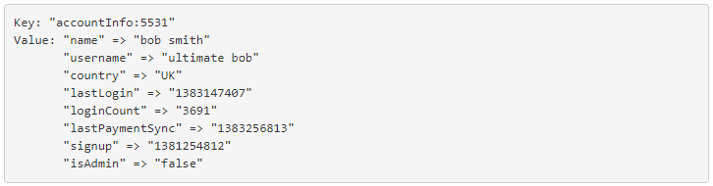
Redis Data Structures
Strings : A sequence of bytes. Strings in Redis are binary safe that can store anything up to 512 megabytes in one string. Example:
Hashes : A collection of key value pairs. Example:

Slide 8
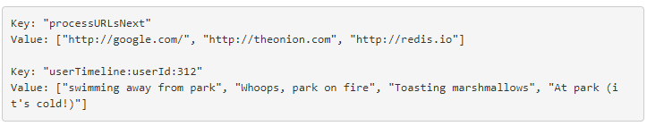
Redis Data Structures
Lists : An in-insertion-order collection of strings. Redis Lists are linked lists. They are collections of string elements that are sorted based on the order that they were inserted. Example:

Slide 9
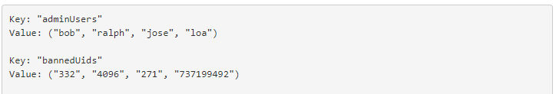
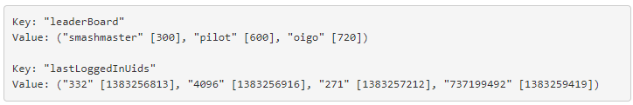
Redis Data Structures
Sets : A collection of unique strings with no ordering. Example:
Sorted sets : A collection of unique strings ordered by user defined scoring Example:

Slide 10
Commands
Part 1 : describe commands Write, Read, Update, and Delete for String data
Part 2: describe important commands and examples for Lists, Sets and Hashes data.
Part 3 : Use case: apply Redis for caching the data in shopping cart system
Notes:
Part3: In this part, we show the use case to apply Redis for caching in shopping cart system by moving login and visitor sessions from relational database to Redis.

Slide 11
Part1: Write, Read, Update, and Delete Commands
Data Types | Meaning | Command
String
Writing Data - to store a value in Redis, we can use the SET command which has the following command:
Reading Data - we can use the GET command to retrieve data for the value of a key:
Updating Data - we can use the SET command to update the value of a key by overwriting its data:
Deleting Data - we can use the DEL command to delete the value of a key by overwriting its data:

Slide 12
Part1: Write, Read, Update, and Delete for String data
Writing Data - to store a value in Redis, we can use the SET command which has the following command:
Reading Data - we can use the GET command to retrieve data for the value of a key:
Updating Data - we can use the SET command to update the value of a key by overwriting its data:
Deleting Data - we can use the DEL command to delete the value of a key by overwriting its data:
SET username jamesbond007
GET username
SET username jamesbond
DEL username

Slide 13
References
Introduction of Redis data types: https://matt.sh/introduction-to-redis-data-types
Redis Data Types: https://www.tutorialspoint.com/redis/redis_data_types.htm
Redis command: https://redis.io/commands
Interactive tutorial: http://try.redis.io/
Install-cli-comands and data types: https://auth0.com/blog/introduction-to-redis-install-cli-commands-and-data-types/
The ReJSON Redis Module: http://rejson.io/

Slide 14

Thank you.

Slide 15
SQL Syntax
SELECT expressions
FROM tables
[WHERE conditions]
[ORDER BY expression [ ASC | DESC ]]
[LIMIT number_rows ]
[ OFFSET offset_value ];

